Slide 1



Vertical slices
Notes:
Hello and welcome everybody to this session of vertical slices.
To get to know each other better, I’d start with a short survey.

Slide 2

https://etc.ch/ZJj8
Notes:
Results: https://directpoll.com/r?XDbzPBd3ixYqg8U1V8c6jY4lscYAcidRK2p4DlxlJjGnXrW

Slide 3
Show sample app with Controller, Service and Repository
Notes:
Let me quickly jump into Rider to show you a sample app with the traditional layered approach.
Here you can see, that we built our solution using Clean Architecture, which means creating projects for each layer like Domain, Application, Infrastructure and Host. This is a common architecture style originally created by uncle bob. No matter which architecture style you use, they aim for a good testability, being independent of frameworks or of the ui, also independent from the database.
This is not always easy, but I won’t dig to deep into that topic because we could talk about that in a few other sessions.
Let me show you a typical request flow, e.g. we have our AuthorController with 3 minimal APIs defined. One for creating an Author, one for getting one by name, and one for getting all for a dropdown select in the frontend. I like to use names to easily identify where our APIs are used in the frontend, let’s say if we build a backend for frontend.
Let me jump into the GetAllAuthorsForDropdownSelect, let’s assume our PO or PM comes to our desk with a small feature request, so that also the Bio of an Authors should be returned in the dropdown select API, because frontend wants to show it. Now we jump to our service class.
What can you see here? What could be a potential problem? -> Overfetching, we at first query all data and to the select in memory afterwards. How could we fix that? We could either create another method in the repository, or we could add a method in the BaseRepository without sending it to the databsse.
I won’t go into much detail here, but I think all of you know projects where this structure is commonly used.
And, you can also image after a few years of development, the services, repositories, controllers get quiet blown up.
What you can also see in this example, that I grouped the code by technical concerns, like Requests, Response, Services.

Slide 4
API Layer
DeviceController
~1.500 LoC
LocationController
Business Layer
DeviceService
~5.000 LoC
LocationService
Persistence Layer
DeviceRepository
~3.000 LoC
LocationRepository
Notes:
This structure is not bad per design, it is as always in software development, it depends. If you are building a CRUD based and small web app, this might be completely fine.
But in most cases, software is never finished and features get added all the time.
So what I want to show you today, is a better approach for starting a new project, or refactor an existing one, if possible.

Slide 5
If you have the feeling that something will break at one end if you change something elsewhere…
…then maybe it's time to think about refactoring your architecture.

Slide 6
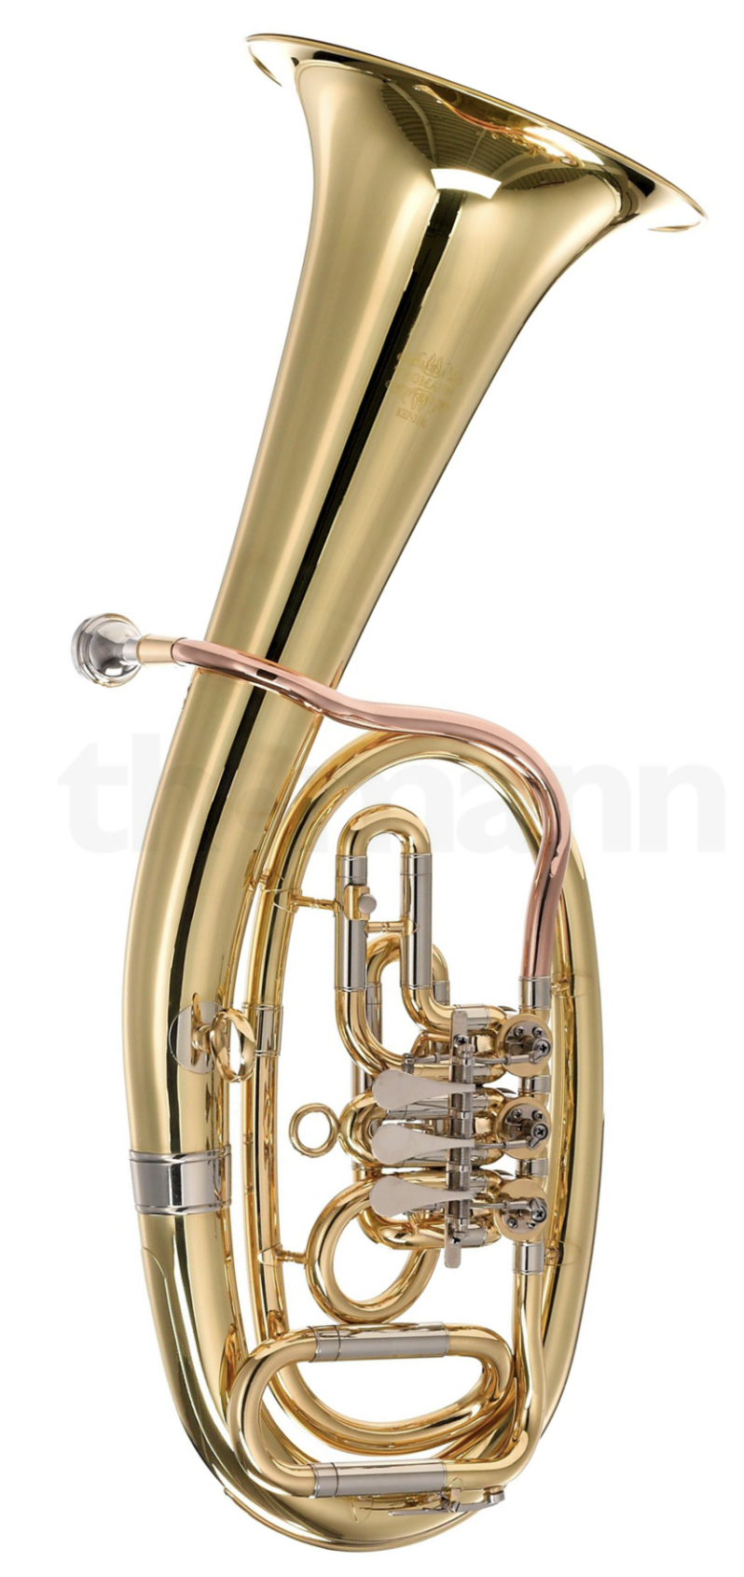



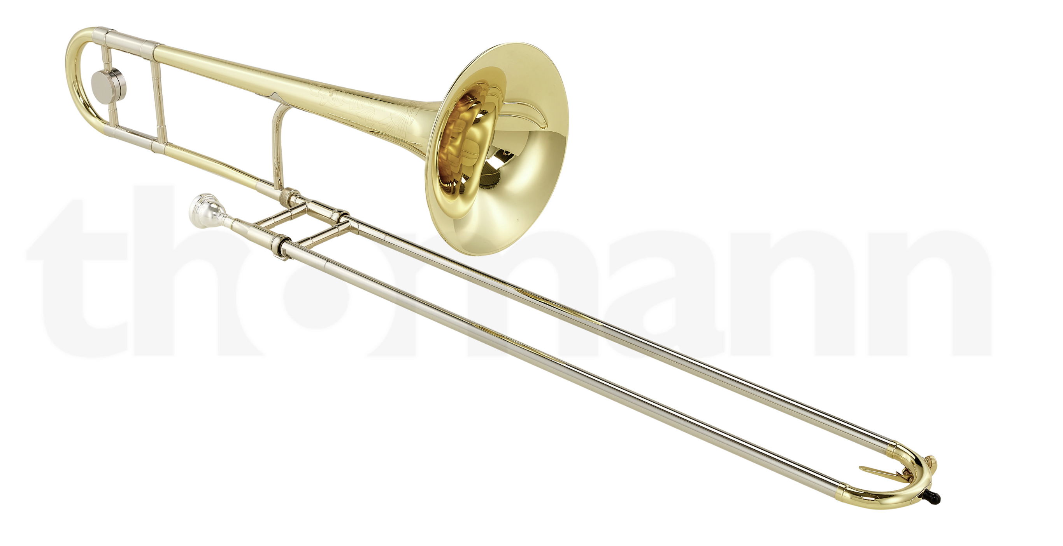

Alexander Pabinger
Freelance Software Developer
Studied Business Informatics at JKU
Product-led software development
Married
1 Son with 2 years
Trombone and Baritone
Notes:
My name is Alexander Pabinger. I’m a rather fresh freelance Software Developer. I studied business informatics at the JKU in Linz. Most of my professional experience, I word in product companies, which I mention because I think you design and structure your code maybe in another way, if you know you will be working on that for the next few years.

Slide 7
What is software architecture?
Hard to define
Structure of the system
What architecture do you use?
Clean Architecture, Hexagonal, Layered, Microservices
...but
Structure of the system
Architecture characteristics
Architecture decisions
Design principles
source: Fundamentals of Software Architecture (Mark Richards & Neal Ford)
Notes:
First of all, I would like to start with a short theory unit before we get to the actual code.

Slide 8
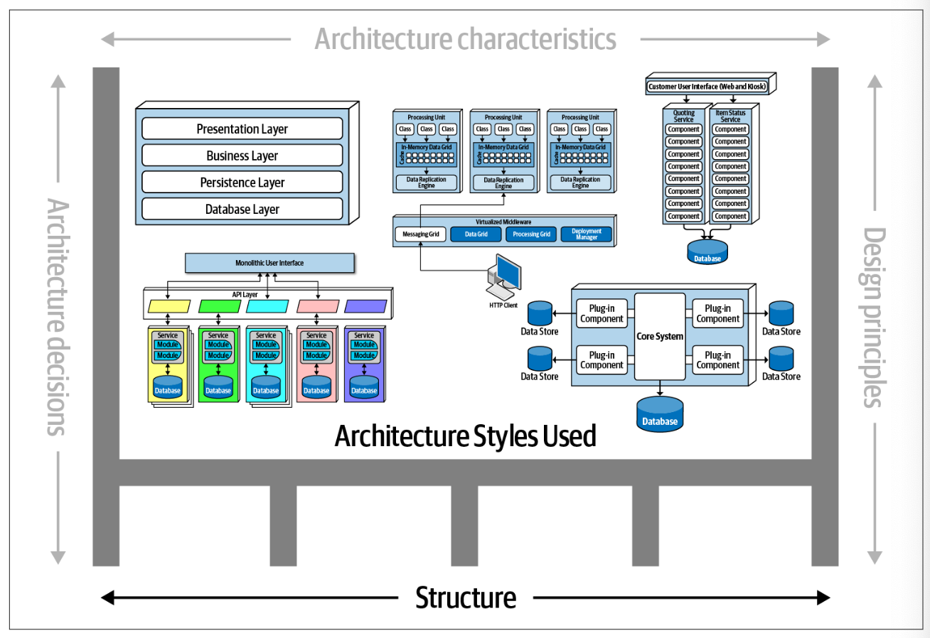
Structure of the system
e.g. Microservices, Layered, Microkernel
source: Fundamentals of Software Architecture (Mark Richards & Neal Ford)

Slide 9
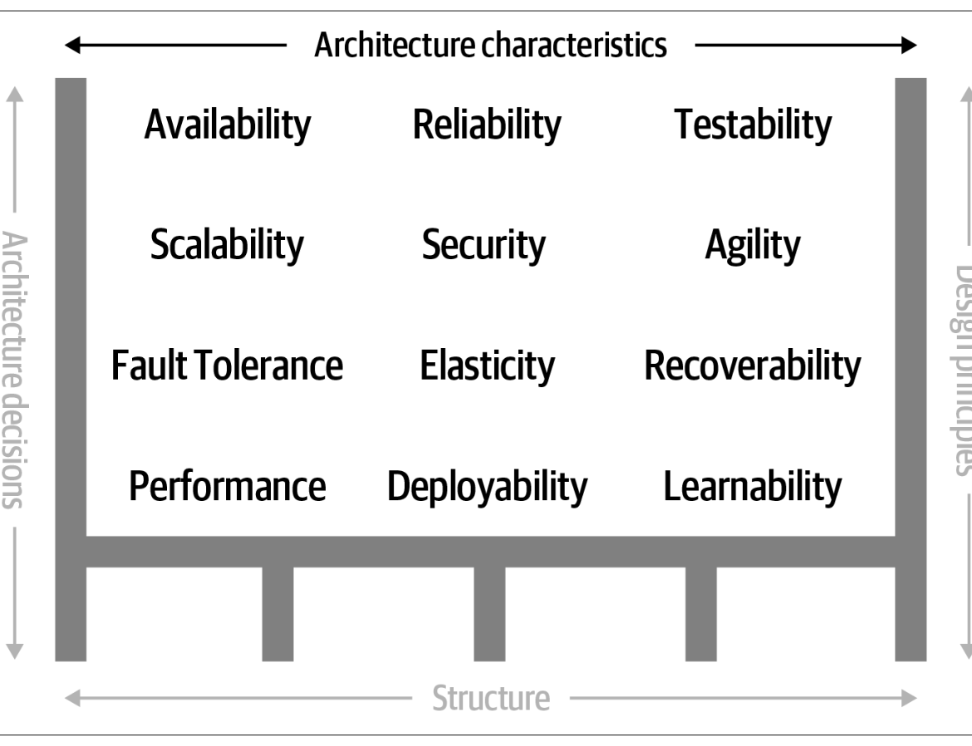
Architecture characteristics
Success criteria of a system
Required for the system to function properly
source: Fundamentals of Software Architecture (Mark Richards & Neal Ford)

Slide 10
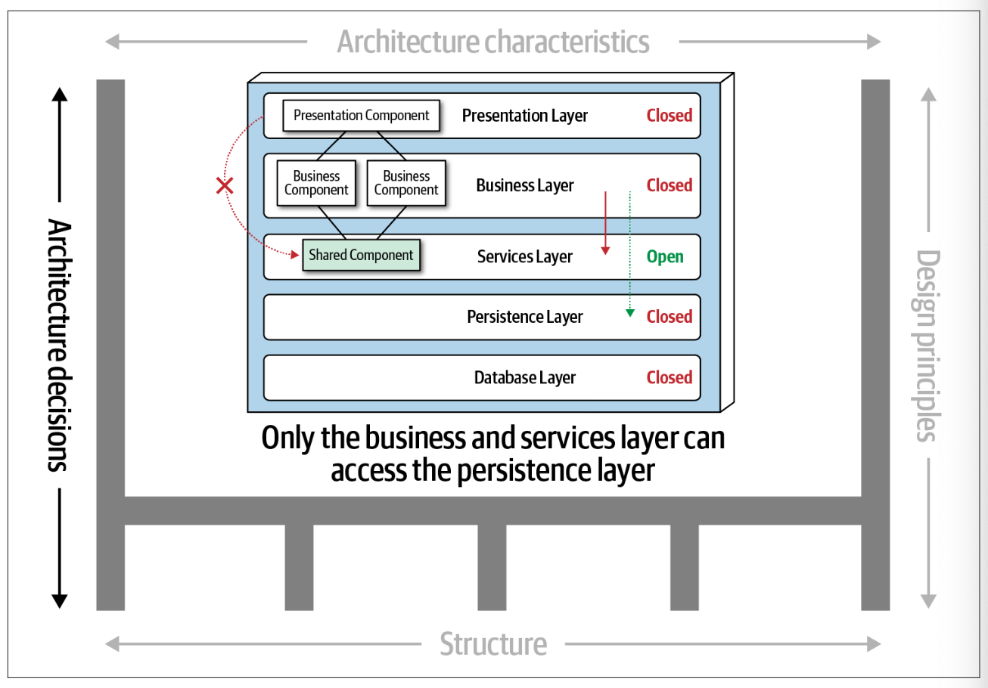
Architecture decisions
Strict Rules
Can be enforced with tests
source: Fundamentals of Software Architecture (Mark Richards & Neal Ford)

Slide 11
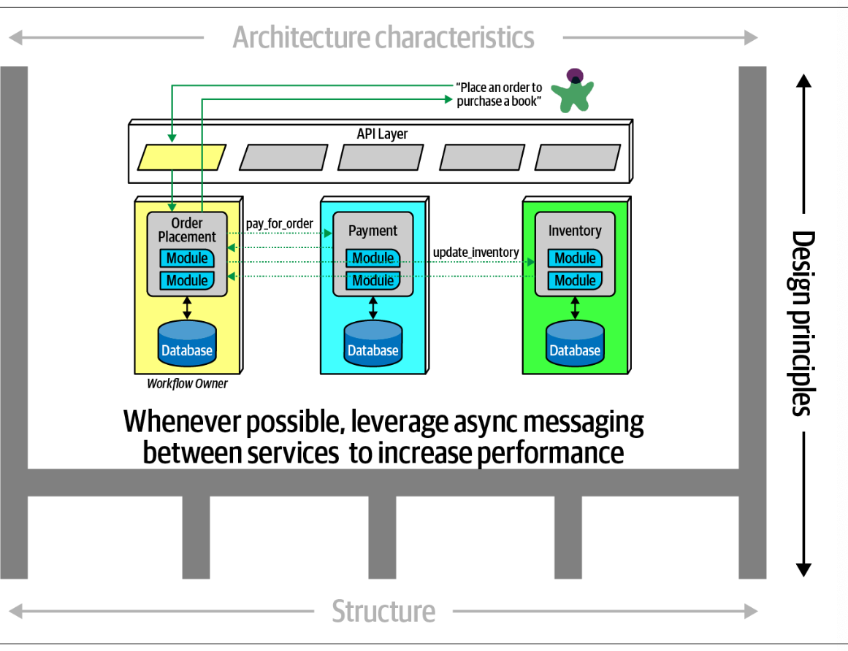
Design principles
Rather a guideline than a rule
e.g. use Async if possible
Ensure in pull requests
source: Fundamentals of Software Architecture (Mark Richards & Neal Ford)

Slide 12
Expectations of an architect
Lead developer? Expert programmer? …
Core expectations
Make architecture decisions
Continually analyze the architecture
Keep current with latest trends
Have business domain knowledge
Possess interpersonal skills
Understand and navigate politics
source: Fundamentals of Software Architecture (Mark Richards & Neal Ford)

Slide 13
Laws of software architecture
“You always die some kind of death” – Philipp Pendelin, softaware
“Everything in software architecture is a trade-off.”
“If an architect thinks they have discovered something that isn’t a trade-off, more likely they just haven’t identified the trade-off yet.”
“Why is more important than how.”

Slide 14

Layered architecture

Slide 15
cohesion

Slide 16
cohesion
“Degree to which the elements inside a module belong together” (Structured Design: Fundamentals of a Discipline of Computer Program and Systems Design)
Form building blocks that have a stronger relationship to each other
Code that belongs together, stays together

Slide 17
coupling

Slide 18
CouplinG
Degree of interdependence between software modules (ISO/IEC/IEEE 24765:2010 systems and software engineering – Vocabulary)
Higher dependency means more likely destabilizing effects

Slide 19
CQS & CQRS

Slide 20
CQS vs cqrs
CQS
CQRS
Command-Query-Separation
Split methods into mutations and queries
Same data store
Command-Query-Responsibility-Segregation
Split the entire system into mutations and queries
Different data stores or read models

Slide 21
5C Design
Not for compilers or interpreters, they don’t care.
Aimed to split software in small parts for human beings to understand the system and keep it maintainable
1. Cut
Cut components wisely
2. Conceal
Conceal as many internal structure as possible
3. Contract
Create interfaces for a smooth communication
4. Connect
5. Construct
Plan dependencies between components explicitly
Components itself can become confusing at one level.
Combine components of one level into a new one of the next higher level.
The more independent, the easier
source: Modulare Softwarearchitektur (Herbert Dowalil) - https://5c-design.info/

Slide 22
5C Design | CUT
Horizontal
Vertical
Feature A
Feature B
Feature C
Feature A
Feature B
Feature C
UI
Service
DB
source: Modulare Softwarearchitektur (Herbert Dowalil) - https://5c-design.info/

Slide 23
Vertical CUT = VERTICAL slices
Vertical slice = Use Case
Build business capabilities
Group classes, methods, files per feature
Contains all code to fulfill a feature
May share code: Services, Domain, DTOs
Not to confuse with Clean or Onion Architecture: Coupling vs Cohesion

Slide 24
PROS AND CONS
PROS
CONS
Improved cohesion
Easy to extend or update features
Less likely that features impact other features
Use the same programming model as always (no pub/sub, messaging, etc. needed)
Infrequent Merge Conflicts
Dev Experience
You don’t ”get rid” of coupling
Code duplication
…

Slide 25
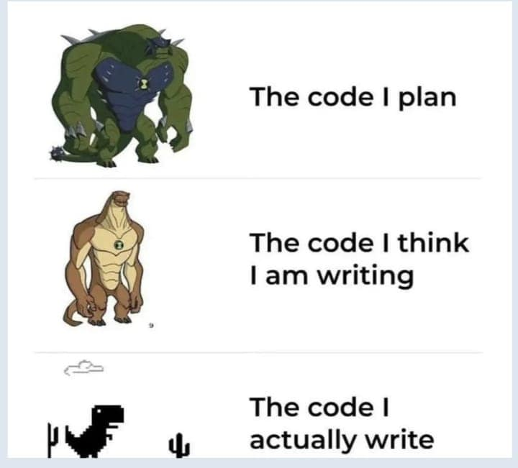
Sample
Show sample application
Create Decorator for Cross-Cutting-Concern
source: https://economistwritingeveryday.com/2024/02/17/programmer-pain-in-memes/

Slide 26
Technical aspects of VSA
It’s about business capabilities, not about Architecture structure like Microservices, Monolith, Modulith, etc.
Business capability = the WHAT? or the capacity to perform a unique business activity
VSA can be used in a monolith, in a modulith, etc
VSA can be used to change a Monolith to a Modulith or Microservice if needed

Slide 27
USE repository?
It depends
Decide if you need an abstraction for DbContext
How we did it?
Inject and use DbContext in all Query Handlers
What about command handlers? How to unit test them?
Data access service per Command Handler (e.g. UpdateNameCommandHandler, UpdateNameDataAccessor)

Slide 28
It’s all about ETC!
easy to change
(The pragmatic programmer – David Thomas and Andrew Hunt)

Slide 29

Thank YOU!
Don’t forget to connect on LinkedIn
Link to Github

